Slide 1
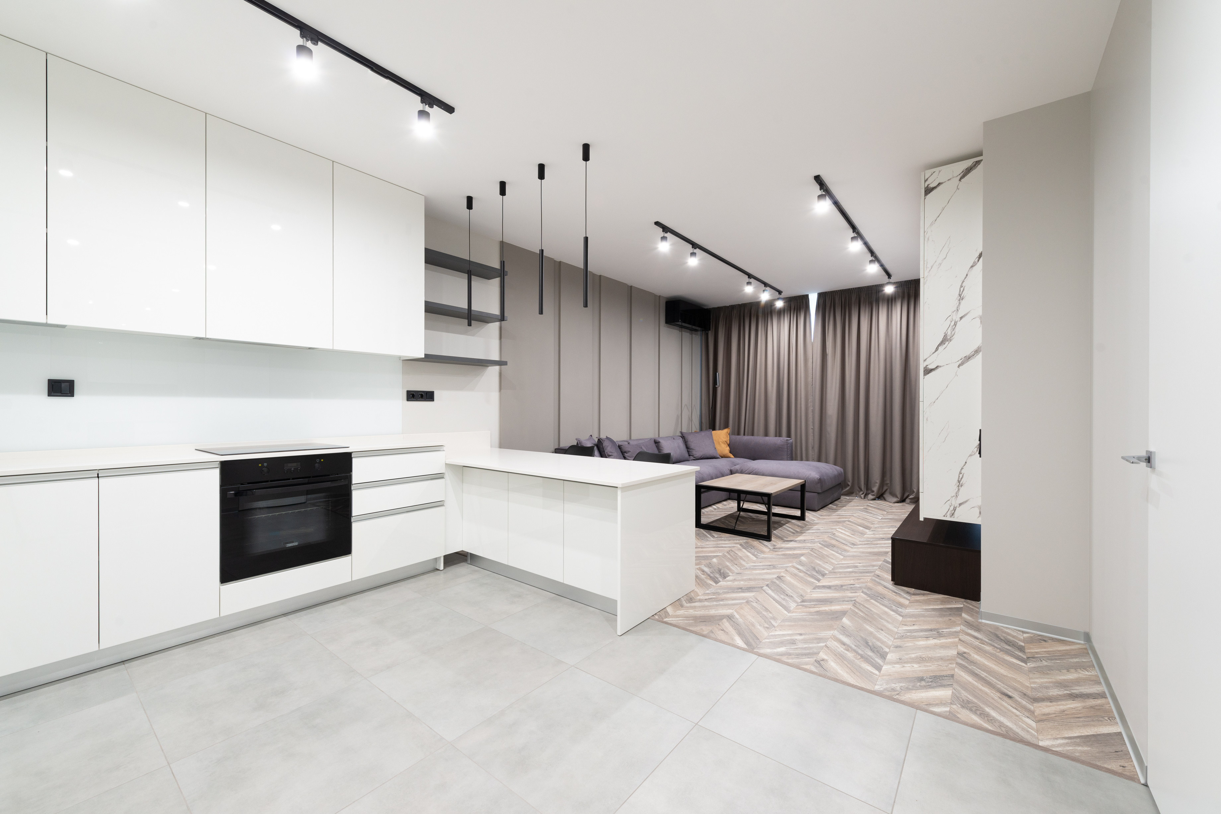
Dubai House Price Trends & Insights
SANJANA KUMARI

Slide 2
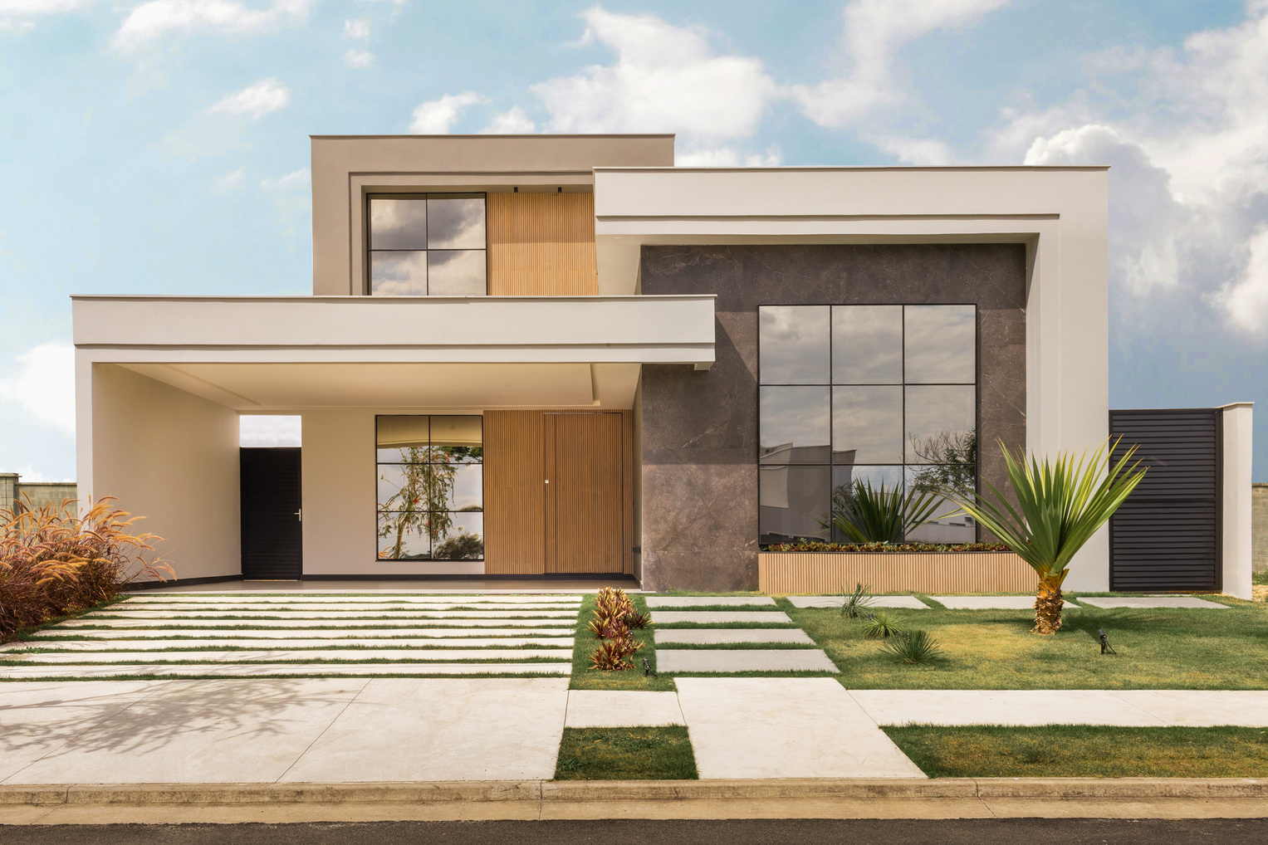
Project
Objective
Goal:
To analyze Dubai's real estate data and uncover insights about property pricing, category distributions, and market behaviors to support decision-making.
Key Questions:
What are the price trends across neighborhoods and years?
How do property size and category influence pricing?
Which segments dominate the listings?

Slide 3
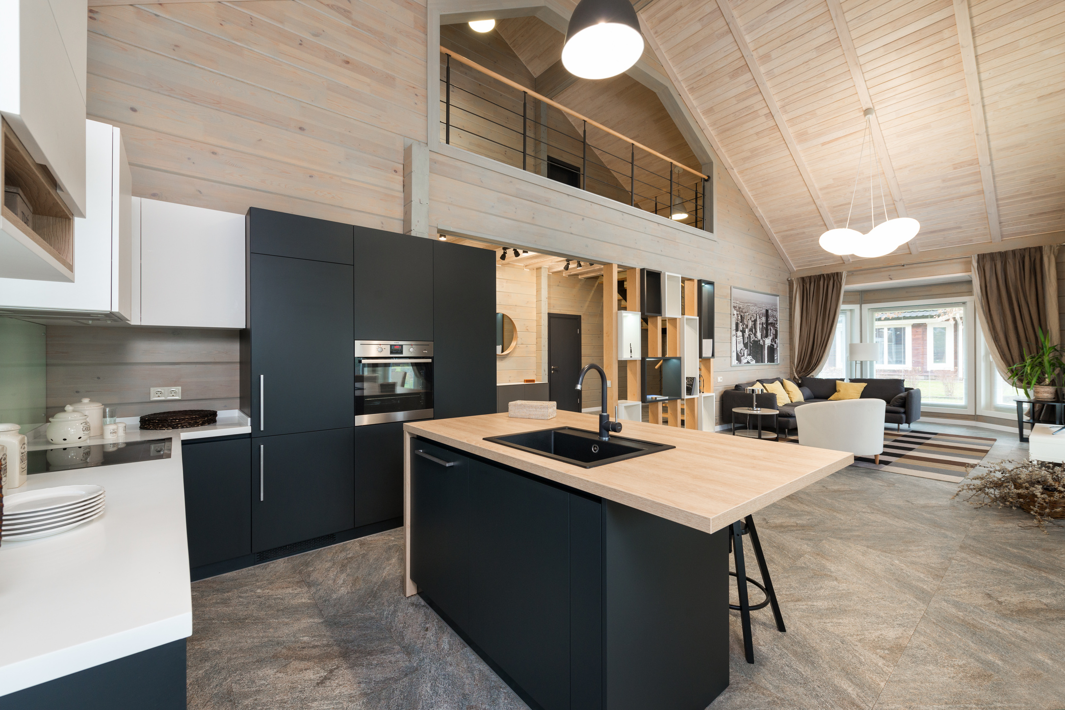
Data Preparation & Tools Used
Dataset:
50,000 Dubai residential property listings (Price, Size, Category, Location, Year, etc.)
Steps Taken:
Excel:
Removed nulls & duplicates
Standardized fields (e.g., Listing Category, Neighborhood)
Changing incorrect data types
Tableau:
Loaded cleaned dataset for visual exploration
Created calculated fields (e.g., Price per sqft , Property Age )
Built filters, hierarchies, and bins for segmentation

Slide 4
Market Overview (KPIs)
Total Listings: 50,000
Average Price: AED 224,833
Average Size: 2,006 sqft
Price per Sqft: AED 113/sqft
Highest Price: AED 492,195
These metrics offer a high-level baseline of the Dubai housing market.

Slide 5
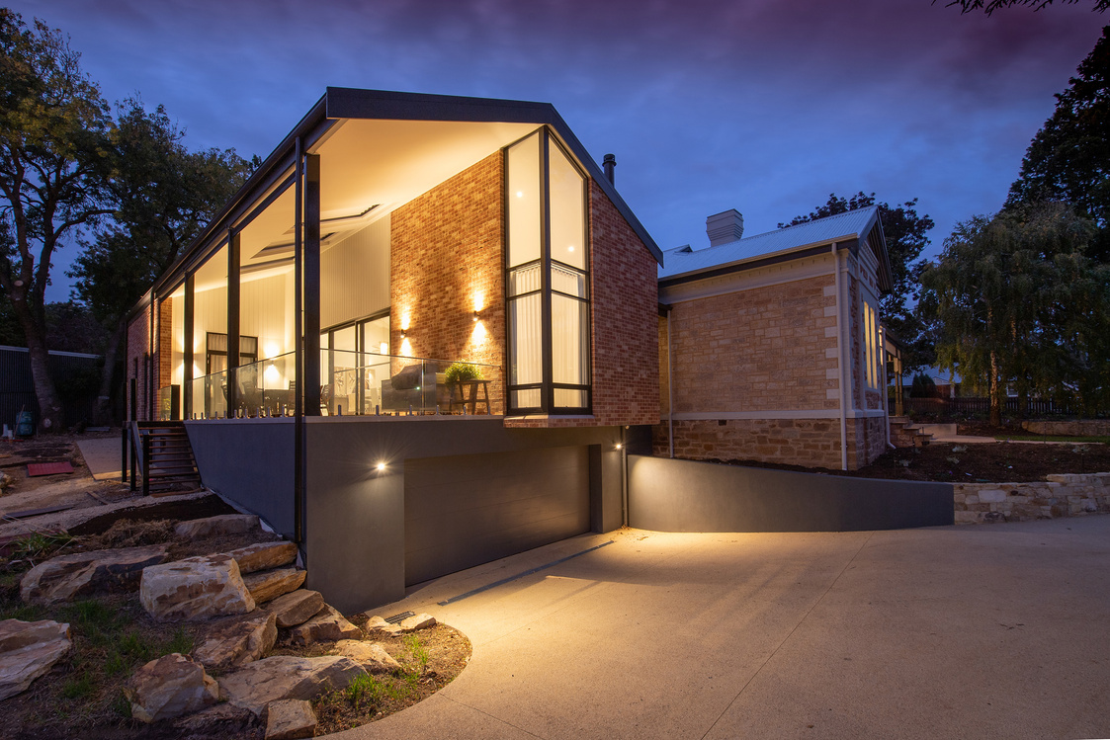
Insight – Mid-Range Dominance
Mid-range listings dominate the Dubai residential market across all bedroom types (2BHK–5BHK). This reflects a strong demand from middle-income buyers and a market equilibrium around affordability and livability.
Implication:
Developers should continue scaling supply in this segment to meet buyer expectations and drive volume.

Slide 6
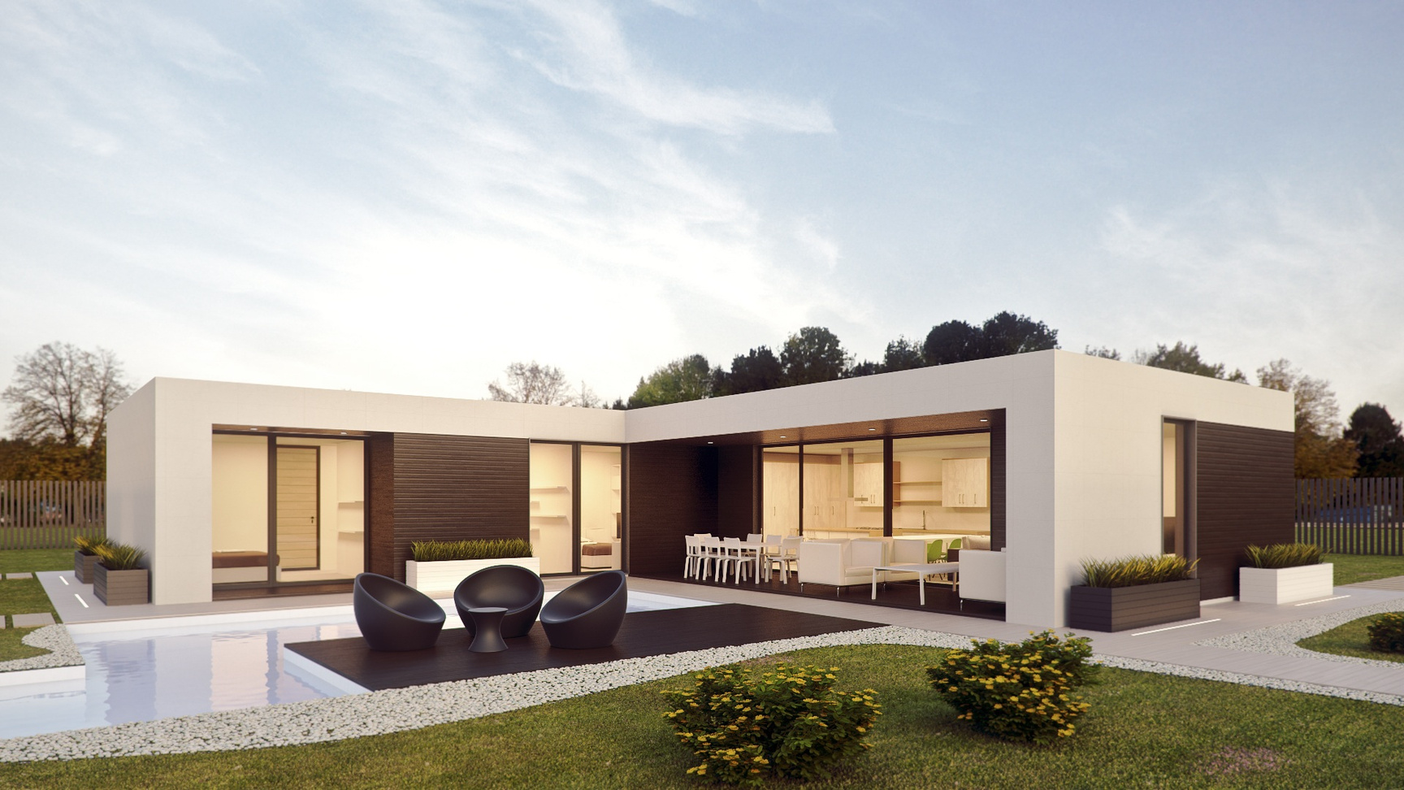
High-End Size Sensitivity
Price growth per square foot is significantly higher in the High-End segment compared to Budget and Mid-Range. This indicates that affluent buyers in Dubai value space premium and are willing to pay disproportionately for size.
Implication:
Marketing of luxury properties should emphasize spaciousness and customizability.

Slide 7
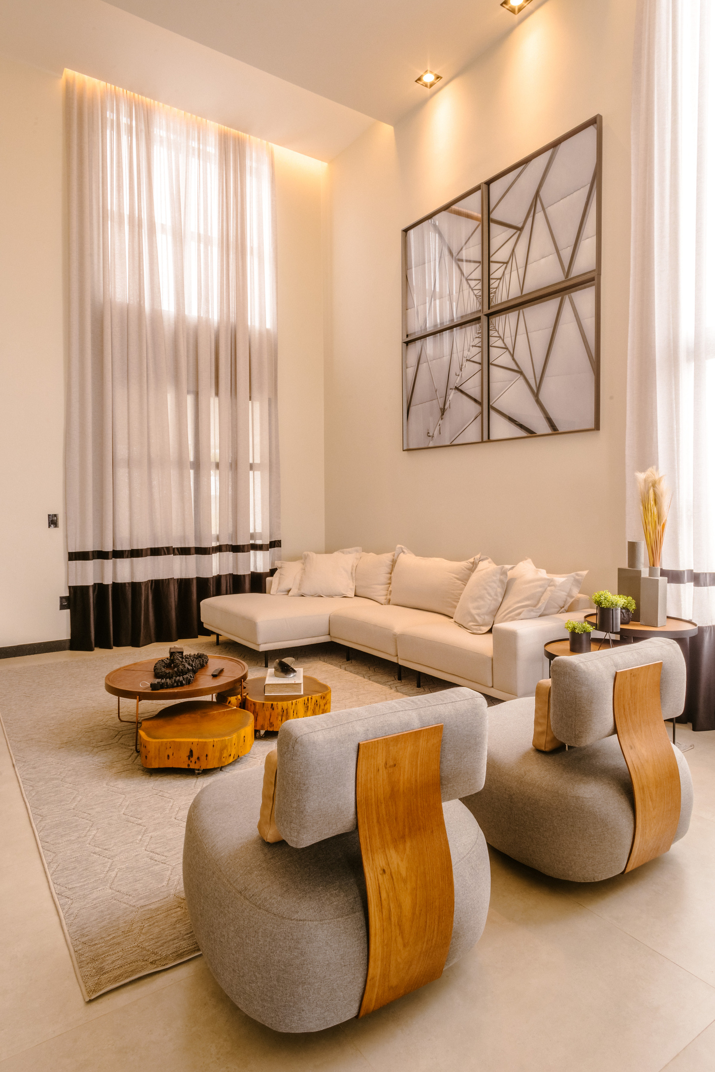
Location Isn’t a Strong Price Differentiator
Average prices across Urban, Suburban, and Rural areas remain tightly clustered (~AED 223K–227K). Unlike other global cities, Dubai's residential pricing is less driven by neighborhood.
Implication: Price modeling should focus on property attributes rather than location alone.

Slide 8
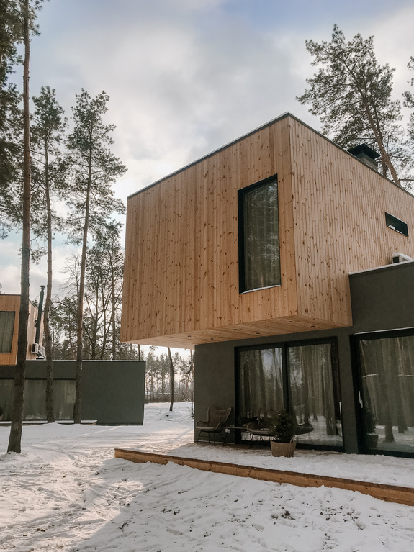
Volatile Long-Term Trends
Analysis of pricing by year built shows significant fluctuations, especially post-2000. There is no steady appreciation trend, suggesting sensitivity to macroeconomic cycles and investment phases.
Implication:
Long-term investment decisions should account for external volatility rather than assuming linear growth.

Slide 9
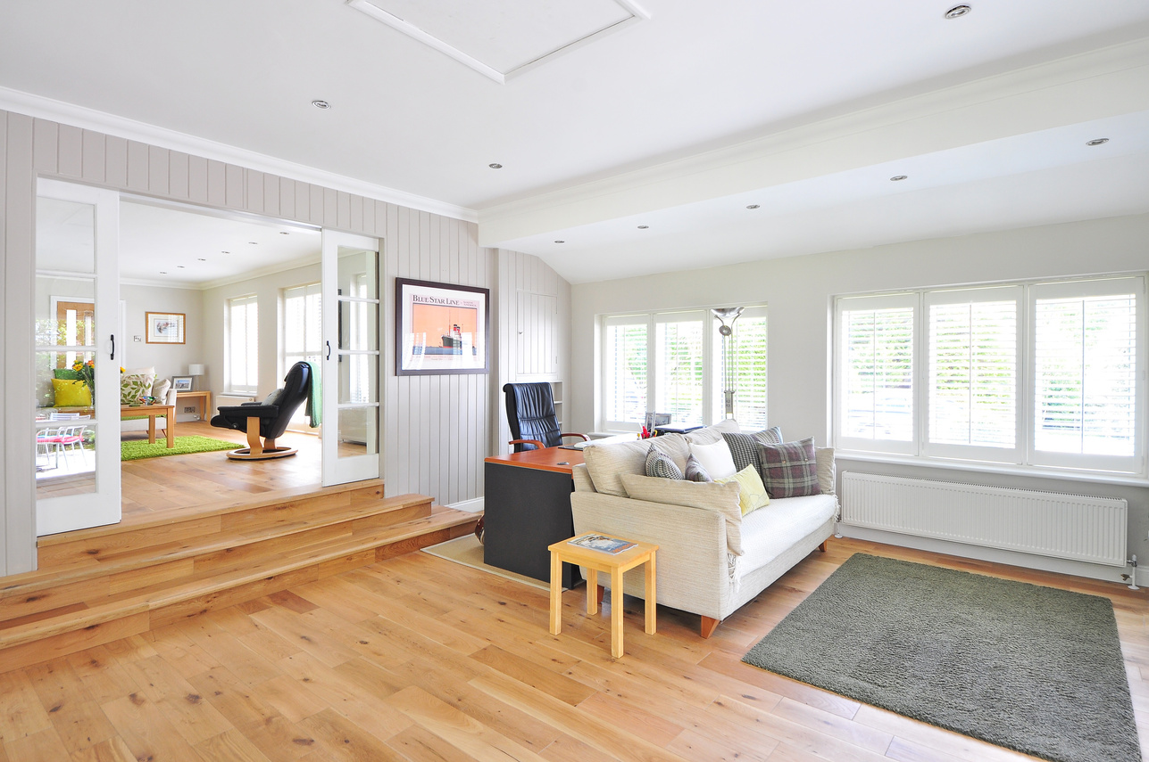
Market Concentration
Listings are highly concentrated in the Mid-Range Urban category. Budget listings are more common in Suburban and Rural regions. High-End listings are underrepresented in Urban zones.
Implication:
There may be untapped opportunity in luxury urban housing or compact high-end apartments.

Slide 10
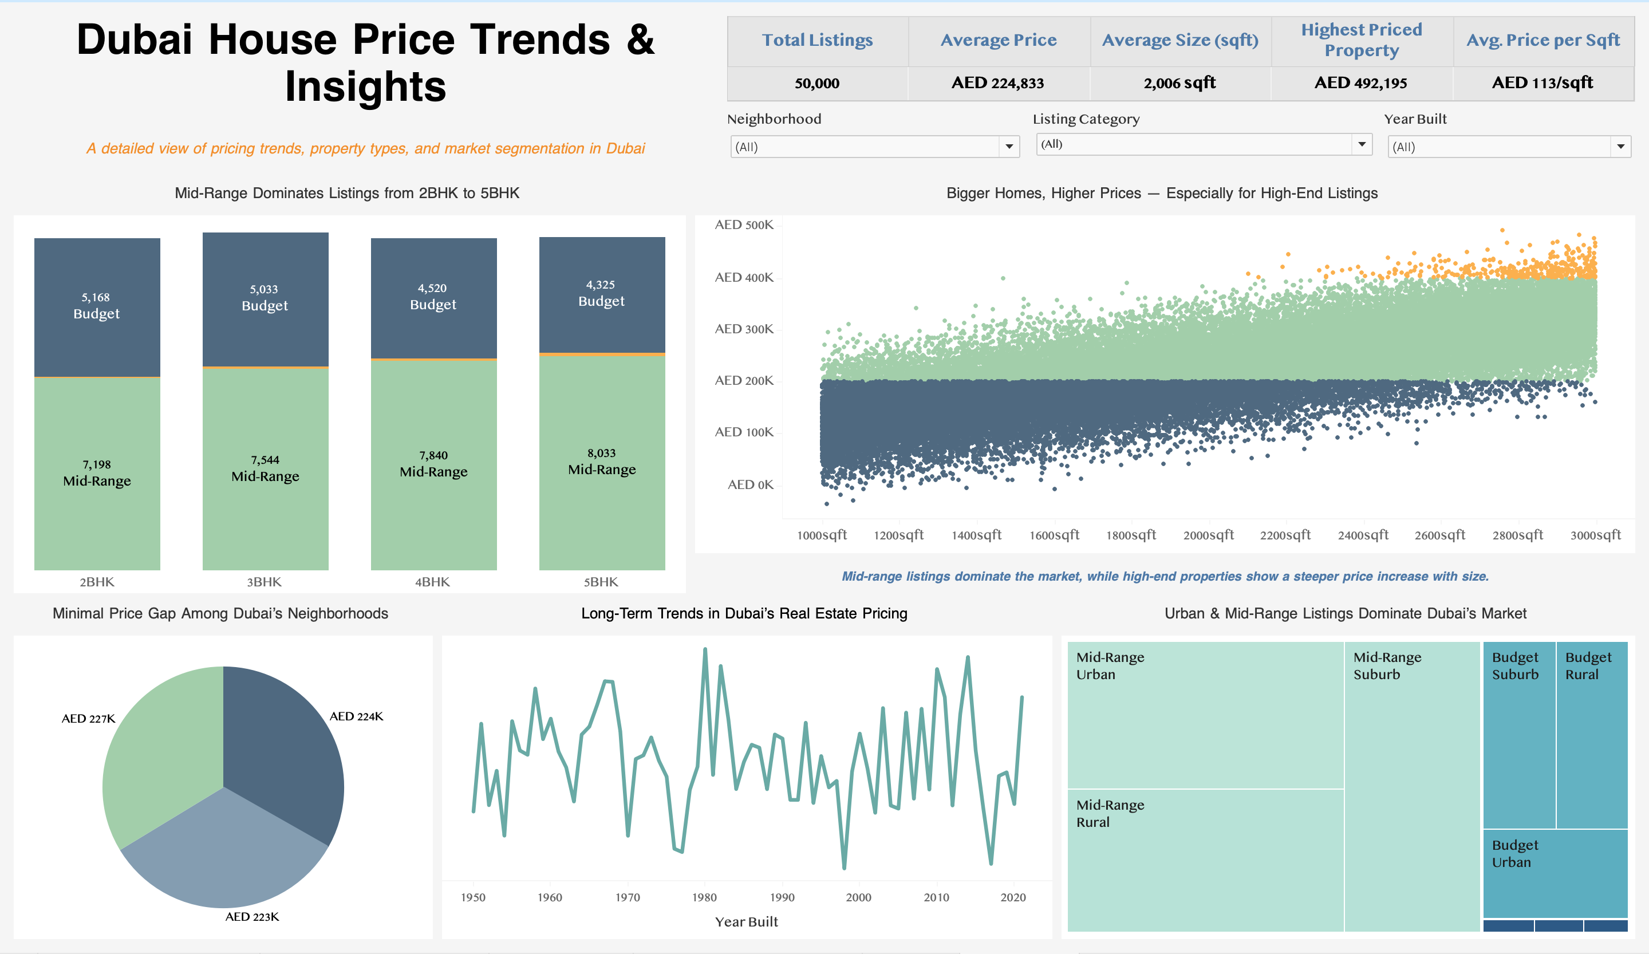

Slide 11
Strategic Recommendations
Prioritize mid-range inventory across all BHK configurations.
Develop high-end properties with scalable luxury space offerings.
Leverage consistent pricing across locations to focus on build quality and amenities.
Monitor macroeconomic indicators when evaluating long-term projects.
Consider affordable luxury solutions for urban buyers.

Slide 12
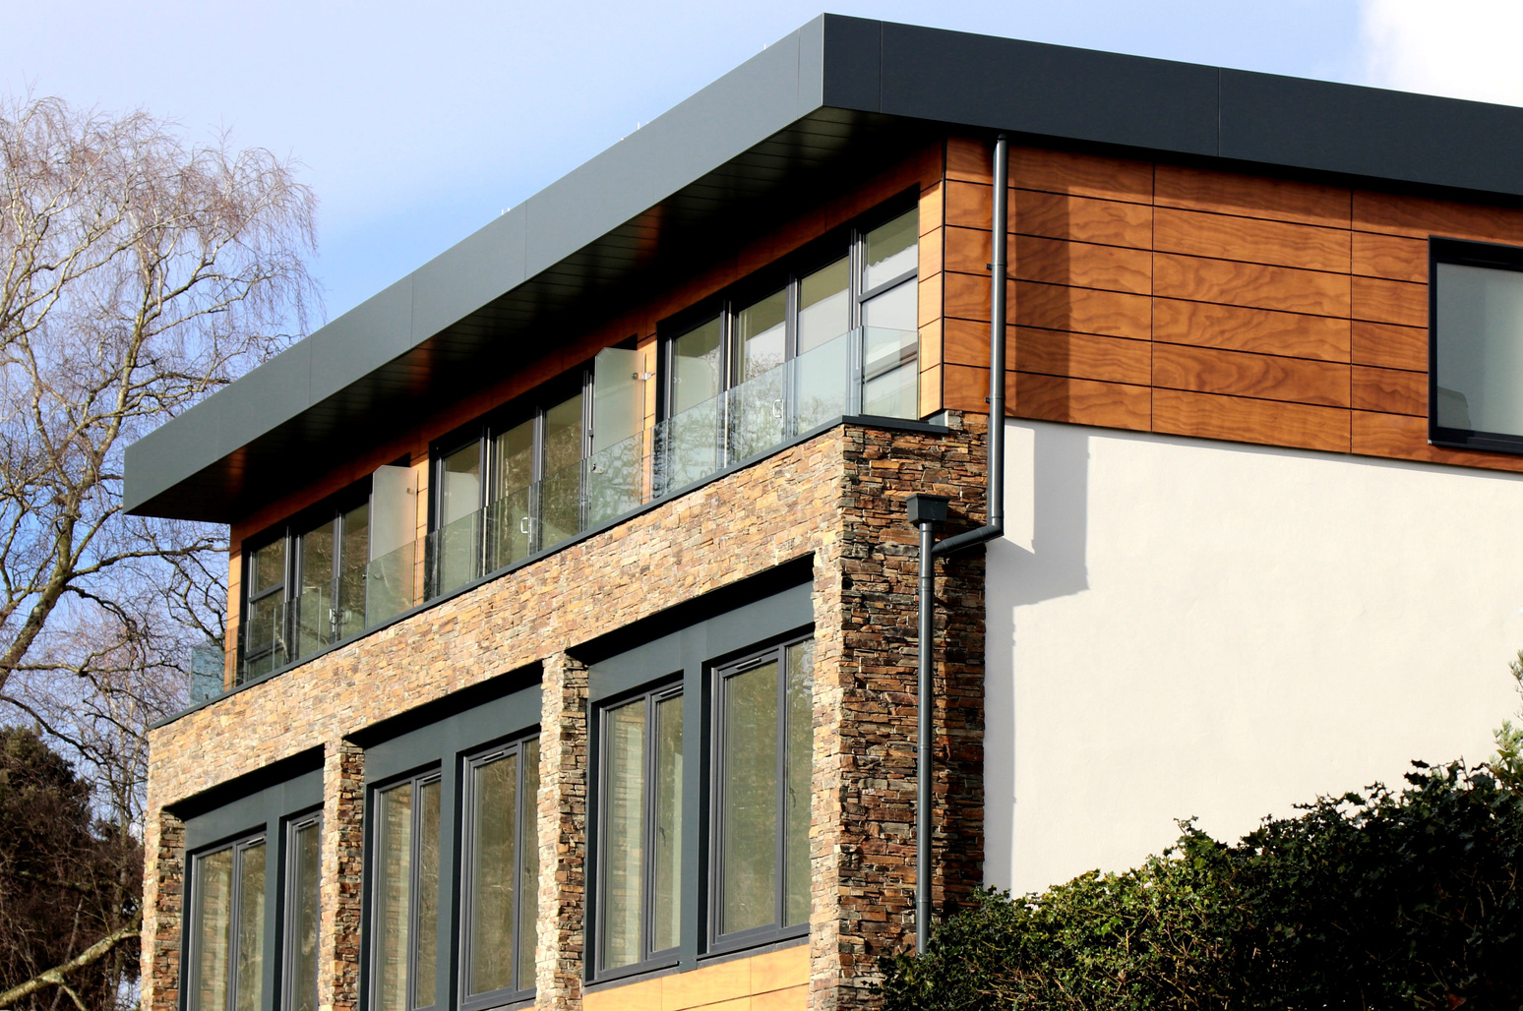


Get in Touch
sanjana.kum1997@gmail.com
https://www.linkedin.com/in/sanjana-kumari-379857167/

Slide 13
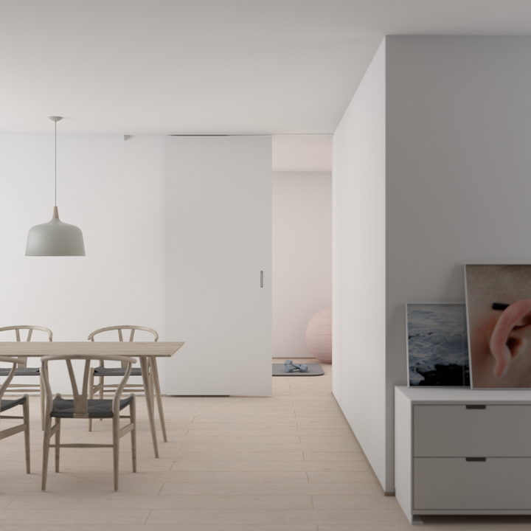
Thank You.

